Slide 1
Environment Pollution: A Global Challenge
Understanding Causes, Effects, and Solutions
Presenter:
Zakia Tabassum
ID: SO-02-07

Slide 2
What is Environmental Pollution?
The introduction of harmful substances or products into the environment indicates environment pollution.
There are several types of environment pollution which are as following:
Air Pollution
Water Pollution
Soil Pollution
Noise Pollution
Light Pollution

Slide 3
Causes of Environmental Pollution
Industrial emissions and vehicle exhaust.
Deforestation and agriculture.
Improper waste disposal and plastic use.
Overpopulation and urbanization.

Slide 4
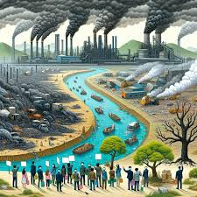
Effects of Pollution on the Environment:
Climate change and global warming.
Habitat destruction and biodiversity loss.
Health issues in humans and animals.
Contamination of resources.

Slide 5
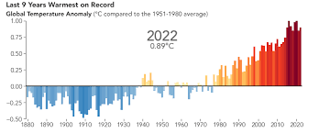
Effects of Pollution on Human Health
- Respiratory and cardiovascular diseases.
- Increased cancer risks.
- Waterborne diseases.
- Psychological impacts of noise and light pollution.

Slide 6

Role of Individuals in Combating Pollution
Reduce, Reuse, Recycle.
Use public transport or carpool.
Avoid single-use plastics.
Spread awareness

Slide 7

Conclusion
Environmental pollution is a global issue that requires collective action.
Small steps by individuals can lead to significant change.

Slide 8
Thank You!
Do you have any questions?

